Slide 1


Power BI
Juicy analytics that work with just about anything

Slide 2


About
https://www.linkedin.com/in/thomascarnevale/
https://github.com/tc-nyc

Slide 3













Common BI Stack Overview

Slide 4


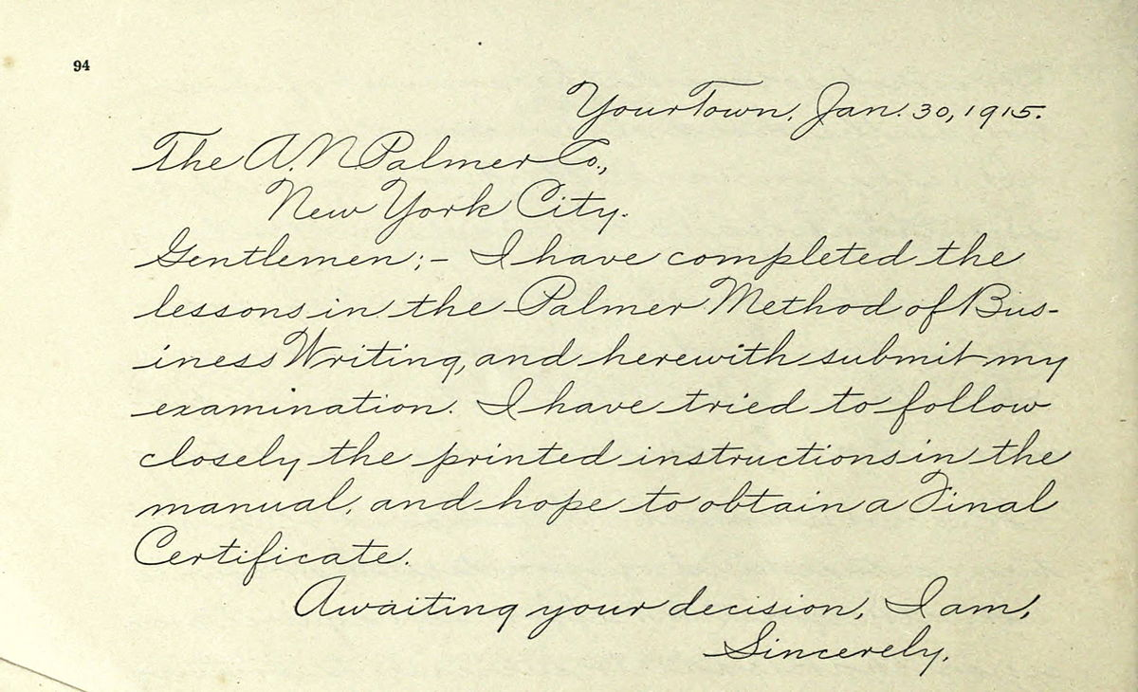
Unconventional data sources

